Slide 1
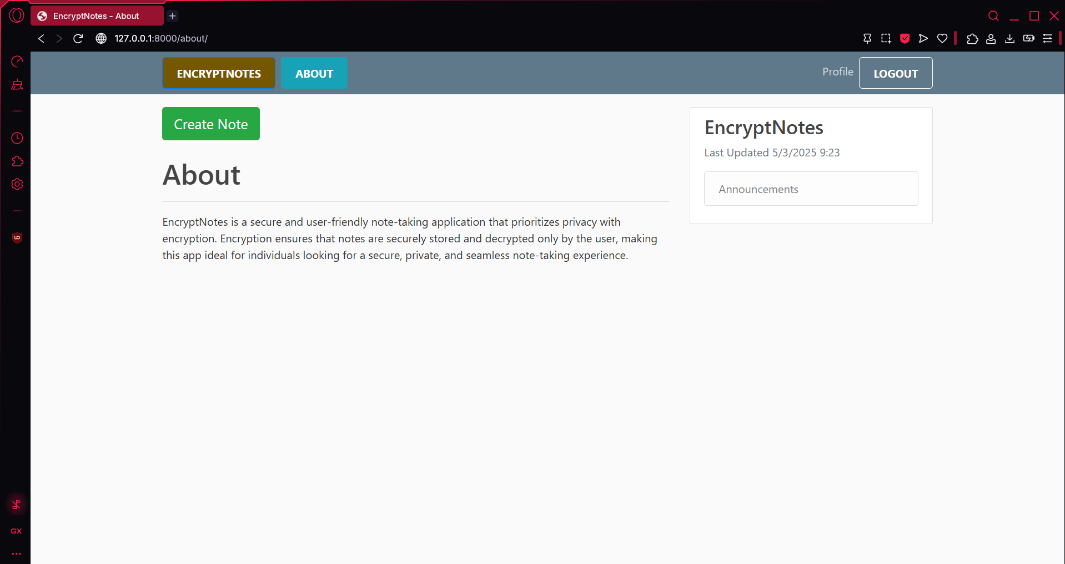
EnCryptNotes Secure and Intelligent Note Management
CPT-200 Team 2 - Phase 4

Slide 2

What is it?
EncryptNotes is secure note taking Web-App
It secures every note you make
Privacy & efficiency are top priorities

Slide 3

Why a Website?
Easily accessible
No downloads
It is a good environment to develop and create our application.

Slide 4
Key Features
End to End Encryption
AI-Powered Categorization
User-Controlled Security Setting
Note Editing and Management
User Account Controls

Slide 5
Technical Overview
Application
Powered by Python and Django
User Authentication
Secure authentication with Django
Encryption
Data encrypted before saving to database
Decrypted upon access from database

Slide 6
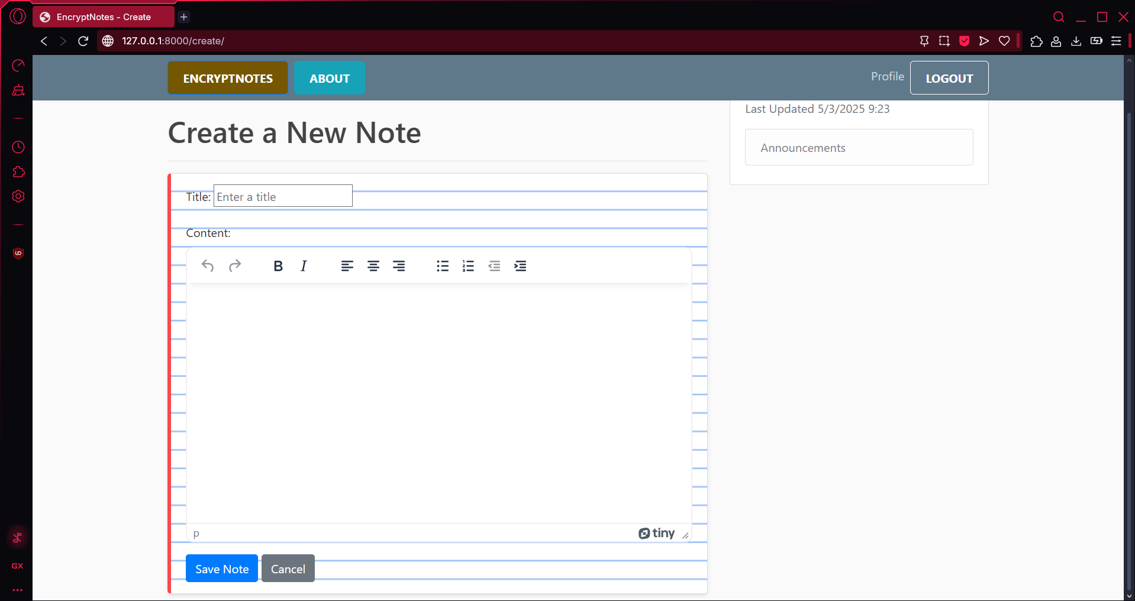
Unique Features
Powerful TinyMCE Editor utilized to create, edit, and view
AI powered note categorization with Google

Slide 7
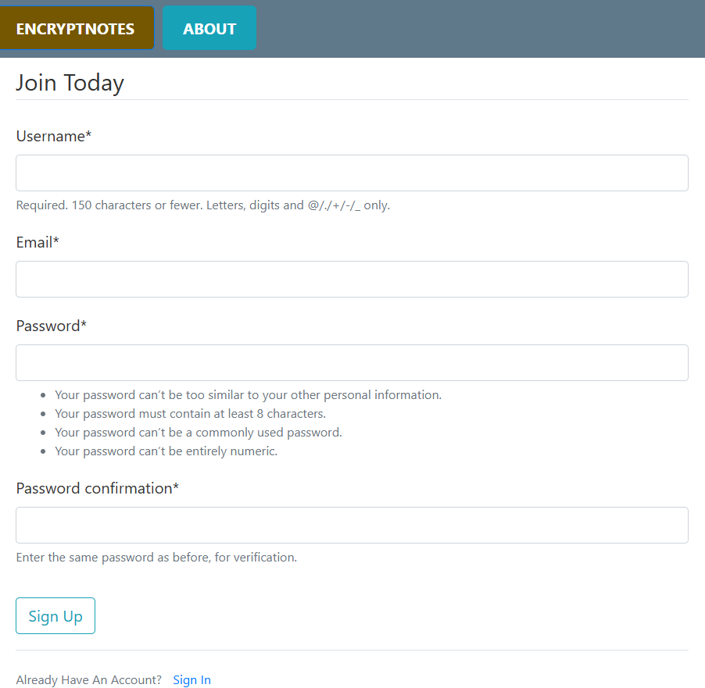
Sign Up Page
Minimum password requirements for enhanced security

Slide 8

Who would use it?
Students – Secure College Notes
Business Professionals – Secure Work Notes
Other Privacy Focused Individual Users

Slide 9
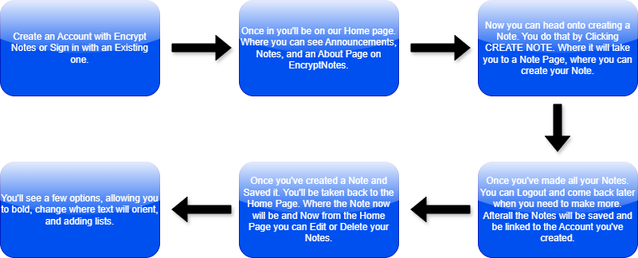
So How Do You Use It?

Slide 10
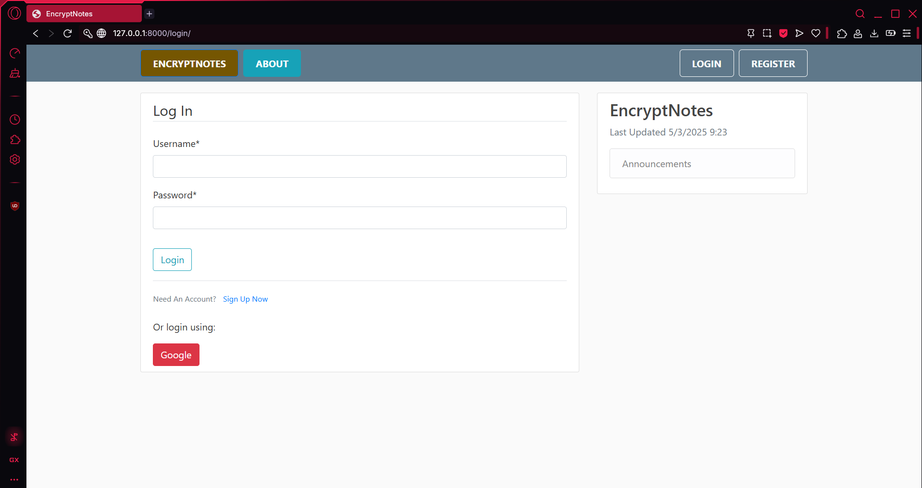
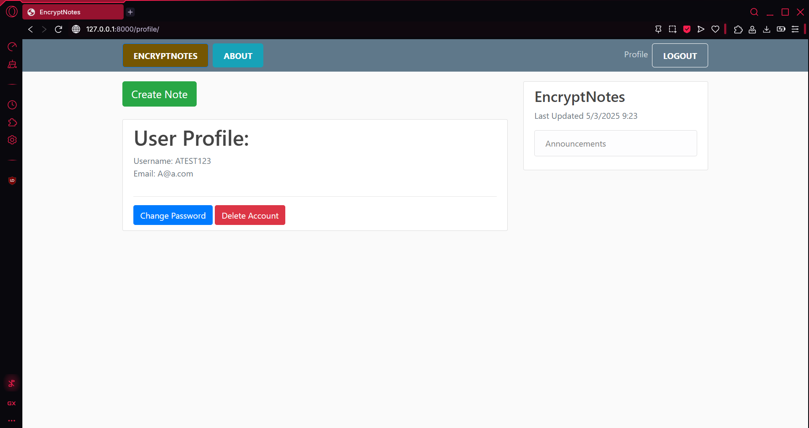
Login/profile page
Here is an Image of the second step.
This is showing the Login page and User page once Logged in.

Slide 11
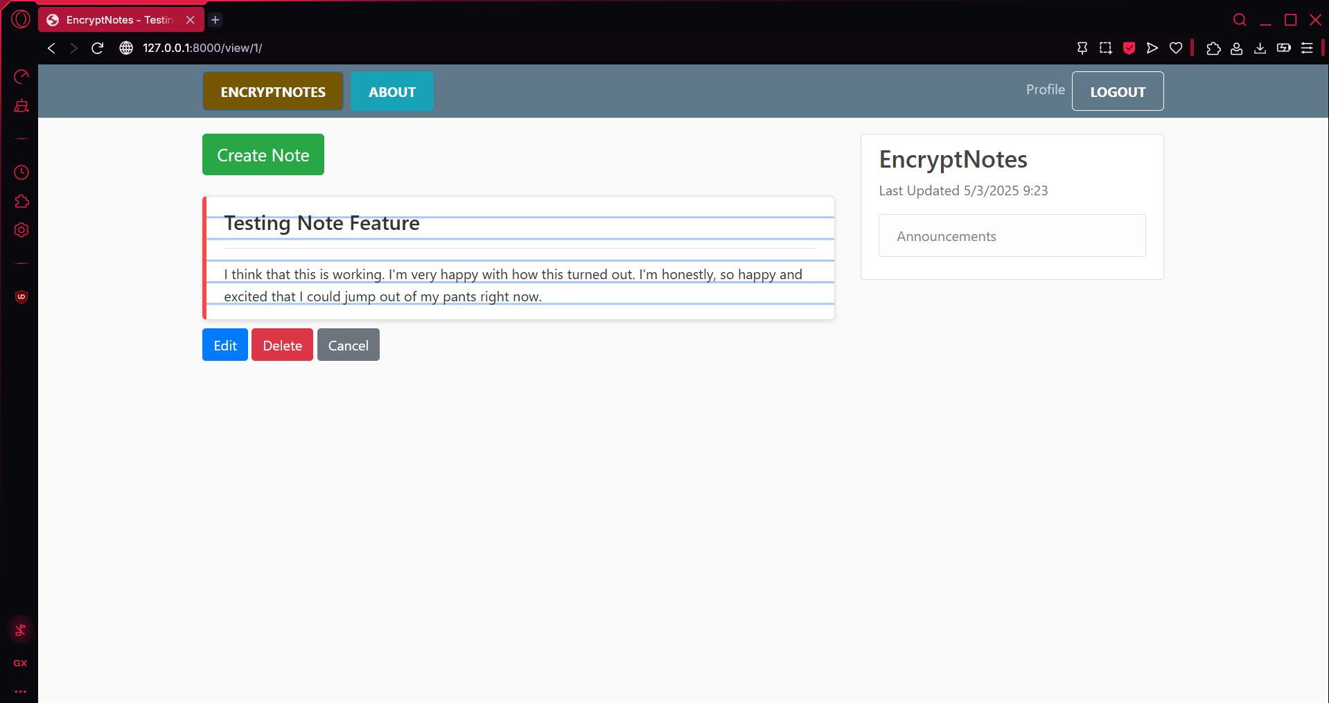
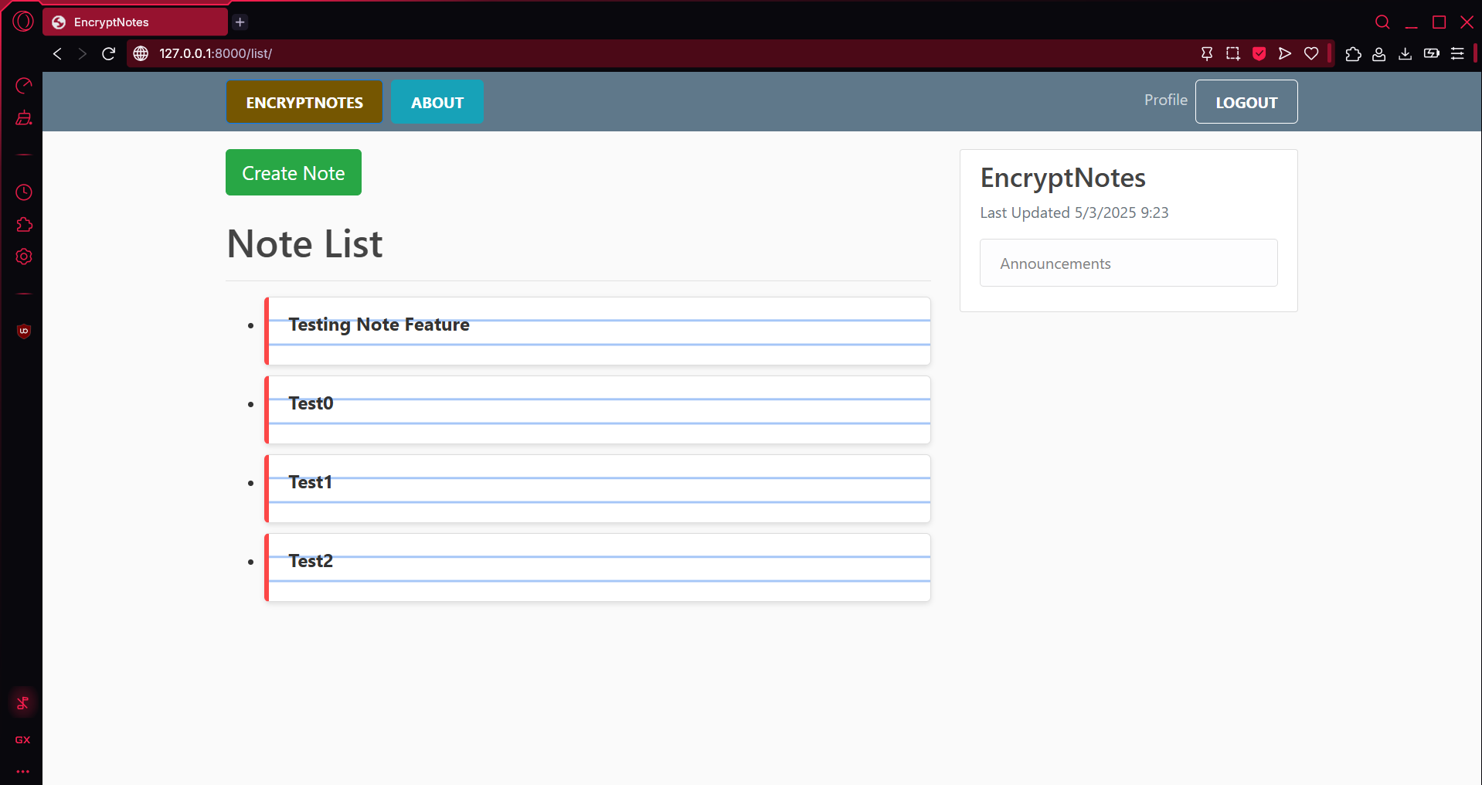
Note Pages

Slide 12
Demo

